Slide 1
Speech sounds and phonetic transcription
Phonetics
  The study of speech sounds used in the languages of the world
Phone
  A speech sound
  Represented with phonetic symbols
  Two types:
    Consonants
    Vowels

Slide 2
Phonology
Phonology is the area of linguistics that describes the systematic way that sounds are differently realized in different environments, and how this system of sounds is related to rest of the grammar.

Slide 3
Speech sounds and phonetic transcription
Phonetic alphabets
  IPA
    Standard developed by International Phonetic Association
    Alphabet + principles of transcription
  ARPAbet
    Designed for American English in ASCII symbols
    Computer-friendly

Slide 4
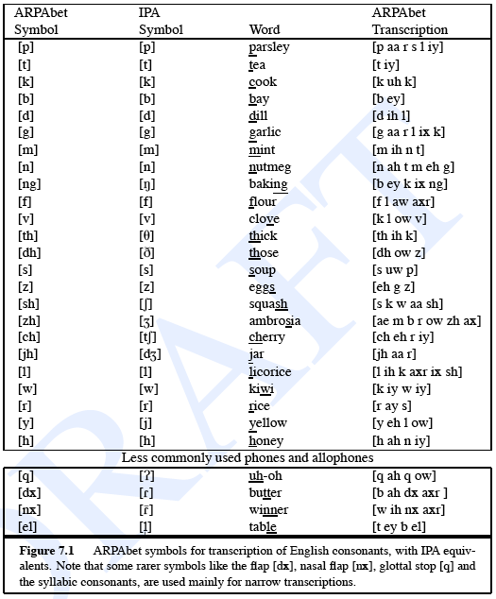
Speech sounds and phonetic transcription
[ɹ]

Slide 5
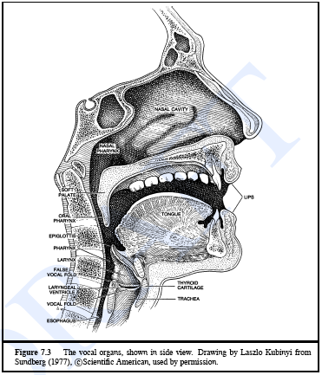
Articulatory phonetics
Definition:
  The study of how phones are produced
The vocal organ

Slide 6
Articulatory phonetics
Consonants are defined by
  Place of articulation
    The point of maximum constriction
  Manner of articulation
    How the restriction of airflow is made
  Voicing
    State of the glottis

Slide 7
Articulatory phonetics
Sounds are formed by the motion of air through the mouth
Consonants:
  Made by restricting or blocking the airflow in some way
  May be voiced(sounds made with vocal folds together and vibrating) or voiceless
Vowels:
  Made with less obstruction
  Usually voiced
  Generally louder and longer than consonants

Slide 8
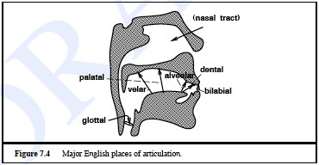
Articulatory phonetics
Place of articulation
coronal

Slide 9
SPEECH PROCESSING

Slide 10
Why Speech?
No visual contact required
No special equipment required
Can be done while doing other things

Slide 11
Speech Processing
Speech Coding
Speech Synthesis
Speech Recognition
Speaker Recognition/Verification

Slide 12

Speech Synthesis
Construct Speech waveform from words
Speaker Quality and Accent

Slide 13
Speech Recognition
Convert a sound waveform to words
The most relevant and important task in the industry
90% in lab conditions, much lower in factory conditions

Slide 14
Speaker Recognition
Concerned with Biometrics
Acceptable as a verification technique
How would this be different from Speech recognition?
  Speaker Quality
  Pitch, Accent etc.

Slide 15
Automatic Speech Recognition
Most Important Task
Hardest Task
  Co-articulation: Two speakers speaking at the same time
  Speaker Variation
  Spontaneity
  Language Modeling
  Noise Robustness

Slide 16
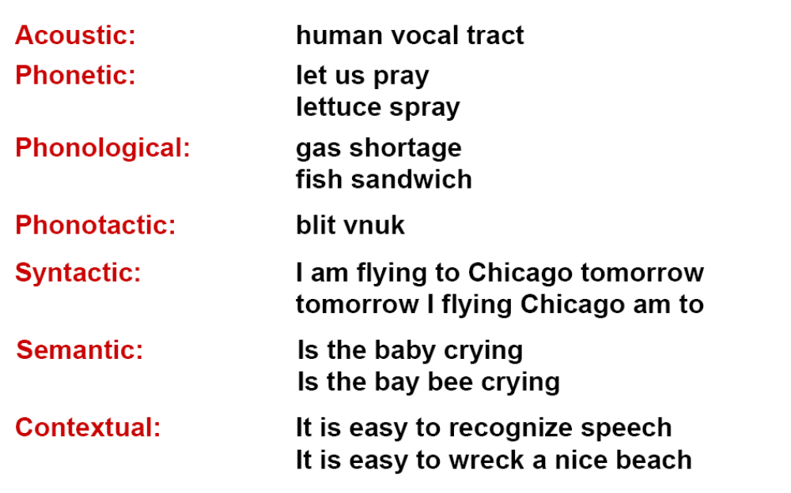
ASR: Problems

Slide 17
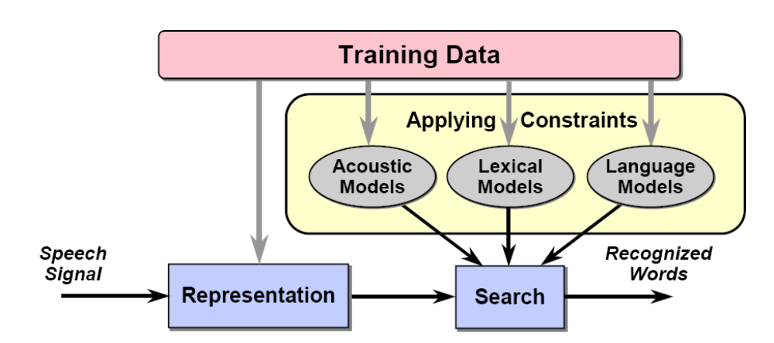
ASR: Method

Slide 18
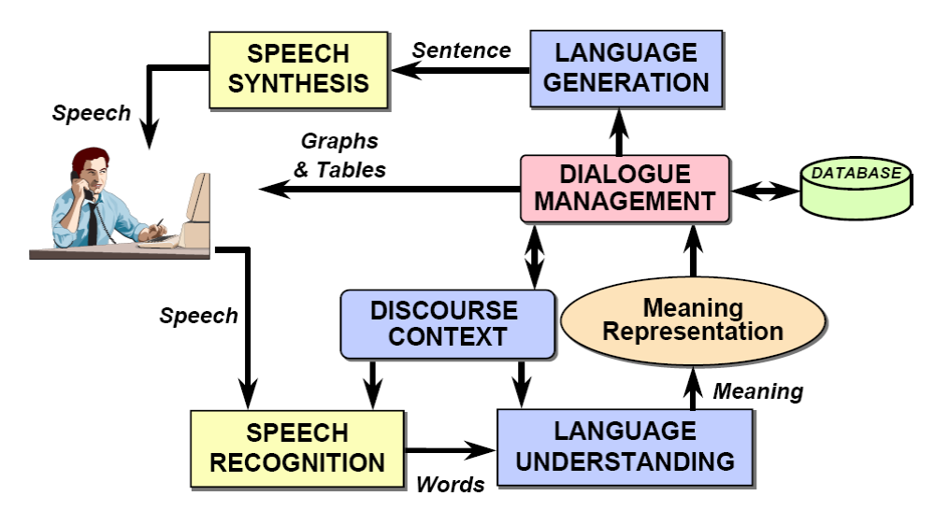
ASR: Application

Slide 19
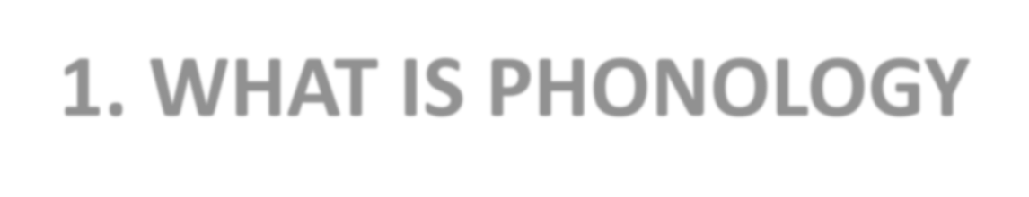
WHAT IS PHONOLOGY

Slide 20
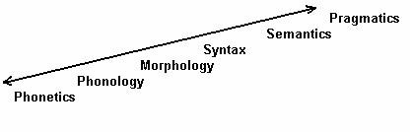










Despite the infinite variations which occur when we speak, all speakers of language agree that certain utterances are the «same» and others are «different». Phonology tells us why this is the case.
Note that, everyone who knows a language knows its phonology unconsciously.

Slide 21
PHONETICS
PHONOLOGY
How are speech sounds made?
How are speech sounds classified?
PHONOLOGY is concerned with the abstract,
PHONETICS is concerned with the physical properties of sounds.
PHONOLOGY is study of sounds in context, PHONETICS is study of sounds in isolation.

Slide 22
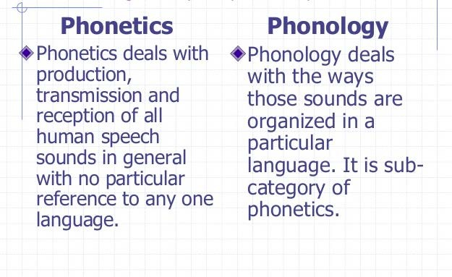

Slide 23
Phonology deals with the following questions:
Why do related forms differ?
What is stored in the mind?
What sounds go together?
How are sounds organized into syllables?
What are the differences between languages?

Slide 24
1. Why do related forms differ?
Sane—Sanity. Electric—Electricity/ Atom—Atomic
Phonology finds the systematic ways in which the forms differ and explains them

Slide 25


2. What is stored in the mind?
Phonology studies abstract mental entities, such as structures and processes.
This contrasts with phonetics, which deals with the actual production and acoustics of the sounds of language.

Slide 26
3. What sounds go together?
Looks at what sounds/sound combinations are accepted and why.

Slide 27
4. How are sounds organized into syllables?
With the use of phonological trees syllables are broken up more easily.
Syllables are made up of a rhyme and an onset (any consonants before the rhyme).
The rhyme made up of a nucleus (the vowel sound(s) in the syllable, the key component of all syllables) and a coda (any consonants following the nucleus).

Slide 28
5. What are the differences between languages?
For example, different languages can use different phonemes, or different syllable structures (what sounds can go together to make sequences or words) and phonology identifies these differences.

Slide 29
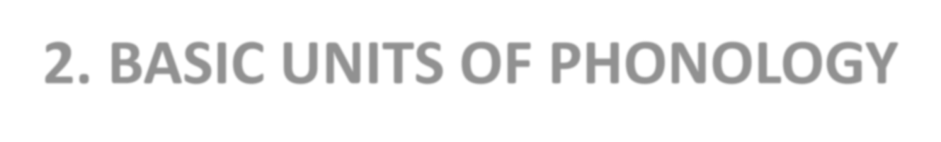
2. BASIC UNITS OF PHONOLOGY

Slide 30
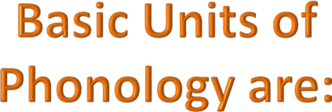
PHONE
PHONEME
ALLOPHONE

Slide 31

Phone is a sound.
It is the smallest unit of sound.
The speech sounds we hear and produce are all phones. It is represented with phonetic symbols.
i.e. [t]

Slide 32

PHONEME is a speech sound that signals a difference in meaning
i.e. dime vs dine
They sound exactly alike but their meanings are different. It is the /m/ and /n/ that made the difference in meaning.

Slide 33




Allophones are variations of the same phoneme.
phoneme
/p/
allophones
[p]
Spit
[ph]
pit

Slide 34
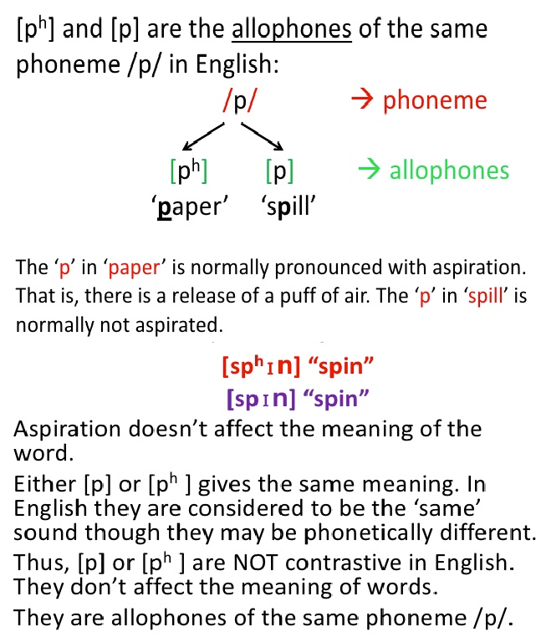

Slide 35
Phonemes: The Phonological Units of Language
Phonemes are the basic unit of sound and are sensed in your mind rather than spoken or heard
Each phoneme has one or more sounds called allophones associated with it, which represent the actual sound being produced in various environments

Slide 36
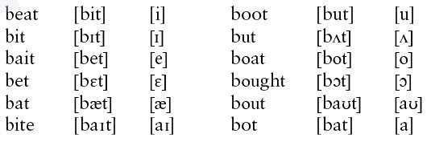
Vowel phonemes in English
When you do these substitutions you are creating minimal pairs, such as in this list:
This list demonstrates that this dialect of English has fourteen diﬀerent vowel phonemes: /i ɪ e ɛ æ u ʊ o ɔ a ʌ/ and /aɪ/, /aʊ/ and /ɔɪ .And all of these phonemes has at least two allophones;

Slide 37
Consonants also have allophones:
tick [t^{h}ɪk] stick [stɪk] hits [hɪts] bi7er [bɪɾər]
  /t/ is pronounced [t^{h}] before a stressed vowel
  /t/ is pronounced [t] directly before or aMer [s]
  /t/ is pronounced [ɾ] between a stressed and unstressed vowel
If we pronounce tick as [tɪk] or [ɾɪk] instead of [t^{h}ɪk], we are still speaking the same word, even if it sounds strange because these allophones of /t/ do not contrast
  However, if we tried to pronounce tick as [sɪk], we would be saying sick, which has a diﬀerent meaning
  The meaning changes because /t/ and /s/ are separate phonemes and do contrast

Slide 38
Distinctive Features of Phonemes
For two phones, or sounds, to contrast meaning there must be some difference between them
– For example, the phonetic feature of voicing distinguishes [s] from [z]
When a feature distinguishes one phoneme from another, it is a distinctive feature or a phonemic feature

Slide 39
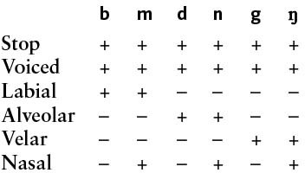
Feature Values
Features have two values: [+ feature] and [-feature] to indicate the presence or absence of that particular feature
– For example, [b] is [+voiced] and [p] is [- voiced]
At least one feature difference must distinguish each phoneme of a language

Slide 40
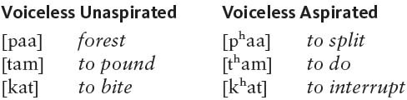
Phonemic Patterns May Vary Across Languages
The same phones may occur in two languages but pattern differently because the phonologies of the languages are different
While aspiration is not distinctive in English, it is distinctive in Thai:

Slide 41
Phonological rules
Phonological rules describe how phonemes are realized as their allophones in the given environment
Environment in phonology typically refers to the neighboring phonemes
Example: In English, the phoneme /t/ is realized as its allophone [ɾ] between a stressed vowel and an unstressed vowel

Slide 42
Formal notation
Formally a phonological rule is written as X -> Y / W _ Z
The variables (X, Y, etc.) can be phonemes, allophones, or features
e.g. /t/ -> [ɾ] / V́ _ V
e.g. [-voice] -> [+voice] / V _ V
Some symbols have special meanings
– #
– $
– +
means word-boundary means syllable-boundary means morpheme boundary

Slide 43
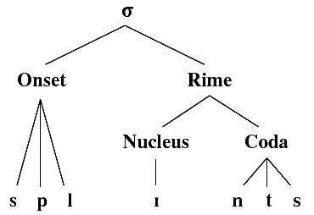
Syllable Structure
Words are composed of one or more syllables, which are phonological units composed of one or more phonemes
  Every syllable has a nucleus, and the nucleus may be preceded and/or followed by one or more phonemes called the onset and the coda
  The rime is the nucleus + the coda

Slide 44


Assimilation Rules
An assimilation rule is a rule that makes neighboring segments more similar by duplicating a phonetic property
– For example, the English vowel nasalization rule states that vowels become nasalized before a nasal consonant within the same syllable

Slide 45
Assimilation Rules
Assimilation rules reflect coarticulation
  Coarticulation is the spreading of phonetic features either in anticipation or in the preservation of articulatory processes
    For example, it is easier to lower the velum while a vowel is being produced before a nasal stop than to wait for the completion of the vowel to then lower the velum even more quickly
There are many assimilation rules in English and other languages
  English plural and past tense morphemes
  Akan negative morphemes

Slide 46
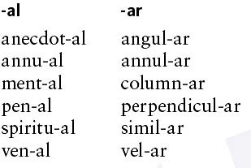
Dissimilation Rules
Languages also have dissimilation rules, in
which a segment becomes less like another segment
– It is sometimes easier to articulate dissimilar sounds
Latin suffix –alis to form adjectives dissimilates to
–aris when an l is in the noun and the dissimilation can be seen in the words borrowed into English

Slide 47
Segment Insertion and Deletion Rules
Phonological rules may also add or delete entire segments
  Adding a segment is known as epenthesis
    The rules for forming plurals, possessives, and third person singular verb agreement in English all involve an epenthesis rule:
Insert a [ə] before the plural morpheme /z/ when a regular noun ends in a sibilant, giving [əz]

Slide 48

Segment Insertion and Deletion Rules
Segment deletion is more common than insertion
  The word memory is often pronounced as if it were spelled memry
  The deletion of [g]:

Slide 49
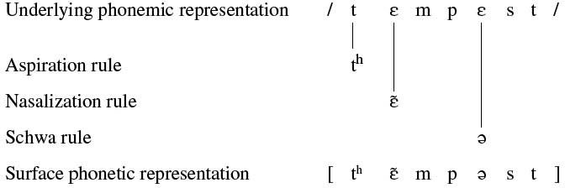
The Function of Phonological Rules
Phonological rules provide the phonetic information necessary for the pronunciation of utterances
– Derivation: the way the phonological rules apply to the underlying phonemic representation to create the phonetic representation:

Slide 50
Probabilistic Approaches to Pronunciation and Spelling

Slide 51
Spoken and Written Word (Lexical) Errors
Variation vs. error
Word formation errors:
  I go to Columbia Universary.
Lexical access problems:
  Turn to the right (left)
  “I called my mother on the television and did not understand the door. It was too breakfast, but they came from far to near. My mother is not too old for me to be young."

Slide 52
Can humans understand ‘what is meant’ as opposed to ‘what is said/written’?
  Aoccdrnig to a rscheearch at an Elingsh uinervtisy, it deosn't mttaer in waht oredr the ltteers in a wrod are, the olny iprmoetnt tihng is taht the frist and lsat ltteers are at the rghit pclae. The rset can be a toatl mses and you can sitll raed it wouthit a porbelm. Tihs is bcuseae we do not raed ervey lteter by itslef but the wrod as a wlohe.
How do we do this?

Slide 53
Detecting and Correcting Spelling Errors
Applications:
  Spell checking in MS word
  OCR scanning errors
  Hand-writing recognition of zip codes, signatures, Graffiti
Issues:
  Correct non-words (dg for dog, but frplc?)
  Correct “wrong” words in context (their for there, words of rule formation)

Slide 54
Patterns of Error
Human typists make different types of errors from OCR systems -- why?
Error classification I: performance-based:
  Insertion: catt
  Deletion: ct
  Substitution: car
  Transposition: cta
Error classification II: cognitive
  People don’t know how to spell (nucular/nuclear)
  Homonymous errors (their/there)

Slide 55

How do we decide if a (legal) word is an error?
How likely is a word to occur?
  They met there friends in Mumbai.
The Noisy Channel Model
  Input to channel: true (typed or spoken) word w
  Output from channel: an observation O
  Decoding task: find w = P(w|O)
Source
Noisy Channel
Decoder

Slide 56
Probability
Experiment: a procedure involving chance that leads to different results
Outcome: the result of a single trial of an experiment;
Event: one or more outcomes of an experiment;
Probability: the measure of how likely an event is;

Slide 57
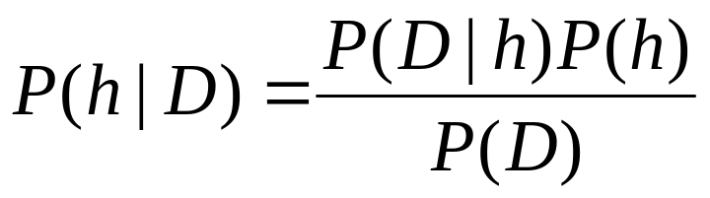

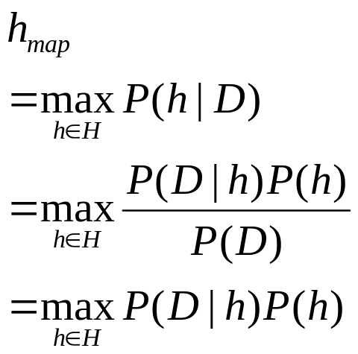
Basic Approach
Bayes Rule:
P(h) = prior probability of hypothesis h
P(D) = prior probability of training data D
P(h|D) = probability of h given D (posterior density )
P(D|h) = probability of D given h (likelihood of D given h)
The Goal of Bayesian Learning: the most probable hypothesis given the training data (Maximum A Posteriori hypothesis )

Slide 58
An Example
Does patient have cancer or not?
A patient takes a lab test and the result comes back positive. The test returns a correct positive result in only 98% of the cases in which the disease is actually present, and a correct negative result in only 97% of the cases in which the disease is not present. Furthermore, .008 of the entire population have this cancer.

Slide 59
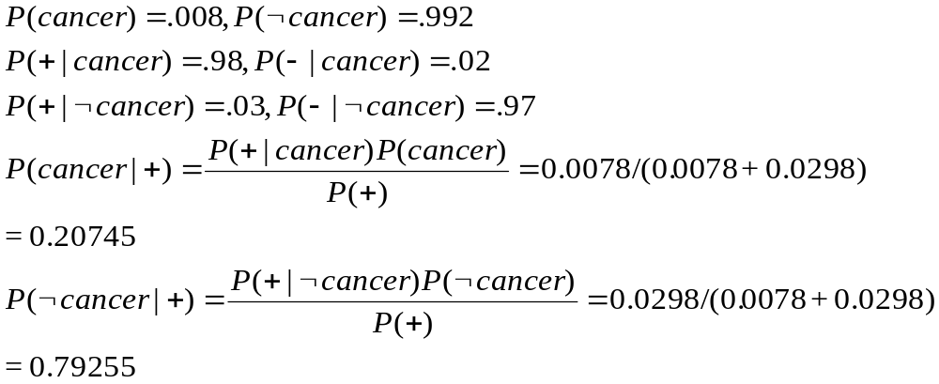

Slide 60
Bayesian Inference
Population: 10 Columbia students
  4 vegetarians, 3 CS major
  Probability that a rcs is a vegetarian? p(v) = .4
  That a rcs who is a vegetarian is also a CS major? p(c|v) = .5
  That a rcs is a vegetarian (and) CS major? p(c,v) = .2

Slide 61

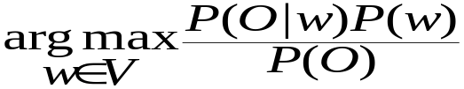
Returning to Spelling...
  Channel Input: w; Output: O
  Decoding: hypothesis w = P(w|O)
  or, by Bayes Rule...
  w =
  and, since P(O) doesn’t change for any entries in our lexicon we are going to consider, we can ignore it as constant, so…
  w = P(O|w) P(w) (Given that w was intended, how likely are we to see O)
Source
Noisy Channel
Decoder

Slide 62
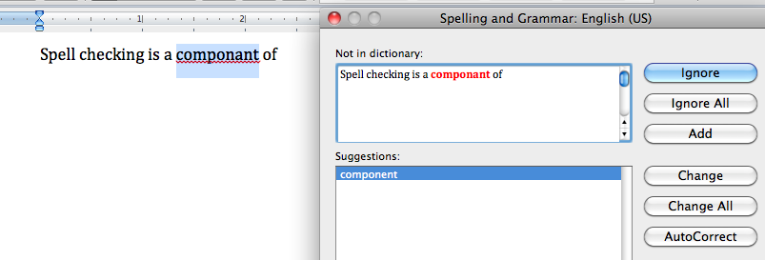
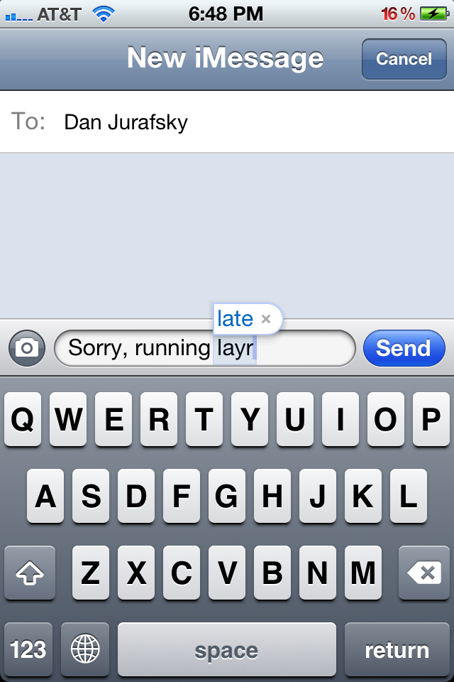
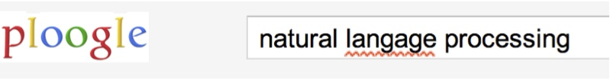

Applications for spelling correction
Word processing
Phones
Web search

Slide 63
Spelling Tasks
Spelling Error Detection
Spelling Error Correction:
  Autocorrect
    hte→the
  Suggest a correction
  Suggestion lists
Notes:
HCI issues and confidence determine.

Slide 64
Types of spelling errors
Non-word Errors
  graffe →giraffe
Real-word Errors
  Typographical errors
    three →there
  Cognitive Errors (homophones)
    piece→peace,
    too → two
    your →you’re
Non-word correction was historically mainly context insensitive
Real-word correction almost needs to be context sensitive

Slide 65
Rates of spelling errors
Depending on the application, ~1–20% error rates
  26%: Web queries Wang et al. 2003
  13%: Retyping, no backspace: Whitelaw et al. English&German
  7%: Words corrected retyping on phone-sized organizer
  2%: Words uncorrected on organizer Soukoreff &MacKenzie 2003
1-2%: Retyping: Kane and Wobbrock 2007, Gruden et al. 1983

Slide 66
Non-word spelling errors
Non-word spelling error detection:
  Any word not in a dictionary is an error
  The larger the dictionary the better … up to a point
  (The Web is full of mis-spellings, so the Web isn’t necessarily a great dictionary …)
Non-word spelling error correction:
  Generate candidates: real words that are similar to error
  Choose the one which is best:
    Shortest weighted edit distance
    Highest noisy channel probability
Notes:
Old school spelling correction

Slide 67
How could we use bayes model to correct spelling errors?
Simplifying assumptions
  We only have to correct non-word errors
  Each non-word (O) differs from its correct word (w) by one step (insertion, deletion, substitution, transposition)
From O, generate a list of candidates differing by one step and appearing in the lexicon, e.g.
Error Corr Corr letter Error letter Pos Type
caat cat - a 2 ins
caat carat r - 3 del

Slide 68
How do we decide which correction is most likely?
We want to find the lexicon entry w that maximizes P(typo|w) P(w)
How do we estimate the likelihood P(typo|w) and the prior P(w)?
First, find some corpora
  Different corpora needed for different purposes
  Some need to be labeled -- others do not
  For spelling correction, what do we need?
    Word occurrence information (unlabeled)
    A corpus of labeled spelling errors

Slide 69
Cat vs Carat
Suppose we look at the occurrence of cat and carat in a large (50M word) AP news corpus
  cat occurs 6500 times, so p(cat) = .00013
  carat occurs 3000 times, so p(carat) = .00006
Now we need to find out if inserting an ‘a’ after an ‘a’ is more likely than deleting an ‘r’ after an ‘a’ in a corrections corpus of 50K corrections (≈ p(typo|word))
  suppose ‘a’ insertion after ‘a’ occurs 5000 times (p(+a)=.1) and ‘r’ deletion occurs 7500 times (p(-r)=.15)

Slide 70
Then p(word|typo) = p(typo|word) * p(word)
  p(cat|caat) = p(+a) * p(cat) = .1 * .00013 = .000013
  p(carat|caat) = p(-r) * p(carat) = .15 * .000006 = .000009
Issues:
  What if there are no instances of carat in corpus?
    Smoothing algorithms
  Estimate of P(typo|word) may not be accurate
    Training probabilities on typo/word pairs
  What if there is more than one error per word?

Slide 71
A More General Approach: Minimum Edit Distance
How can we measure how different one word is from another word?
  How many operations will it take to transform one word into another?
  caat --> cat, fplc --> fireplace (*treat abbreviations as typos??)
  Levenshtein distance: smallest number of insertion, deletion, or substitution operations that transform one string into another (ins=del=subst=1)
  Alternative: weight each operation by training on a corpus of spelling errors to see which most frequent

Slide 72
Dynamic Programming
Dynamic Programming is an algorithm design technique for optimization problems: often minimizing or maximizing.
Like divide and conquer, DP solves problems by combining solutions to subproblems.
Unlike divide and conquer, subproblems are not independent.
  Subproblems may share subsubproblems,
  However, solution to one subproblem may not affect the solutions to other subproblems of the same problem. (More on this later.)
DP reduces computation by
  Solving subproblems in a bottom-up fashion.
  Storing solution to a subproblem the first time it is solved.
  Looking up the solution when subproblem is encountered again.
Key: determine structure of optimal solutions
Comp 1

Slide 73
Edit Distance
One measure of similarity between two strings is their edit distance.
This is a measure of the number of operations required to transform the first string into the other.
Single character operations:
  Deletion of a character in the first string
  Insertion of a character in the first string
  Substitution of a character from the second character into the second string
  Match a character in the first string with a character of the second.

Slide 74
Edit Distance
Example from textbook: transform vintner to writers
vintner replace v with w → wintner
wintner insert r after w → wrintner
wrintner match i → wrintner
wrintner delete n → writner
writner match t → writner
writner delete n → writer
writer match e → writer
writer match r → writer
writer insert s → writers

Slide 75
Edit Distance
Let Σ = {I, D, R, M} be the edit alphabet
Defn. An edit transcript of two strings is a string over Σ describing a transformation of one string into another.
Defn. The edit distance between two strings is defined as the minimum number of edit operations needed to transform the first into the second. Matches are not included in the count.
Edit distance is also called Levenshtein distance.

Slide 76
Edit Distance
Defn. An optimal transcript is an edit transcript with the minimal number of edit operations for transforming one string into another.
Note: optimal transcripts may not be unique.
Defn. The edit distance problem entails computing the edit distance between two strings along with an optimal transcript.

Slide 77
Dynamic Programming
Observation 1: There are many possible ways to transform one string into another.
Observation 2: This is like the knapsack problem
Recall: dynamic programming is used to solve knapsack-like problems.
Defn. Let D(i,j) denote the edit distance of S₁[1..i] and S₂[1..j].
  That is, D(i,j) is the minimum number of edit ops needed to transform the first i characters of S₁ into the first j characters of S₂.

Slide 78
Dynamic Programming
Notice that we can solve D(i,j) for all combination of lengths of prefixes of S₁ and S₂.
Examples: D(0,0),.., D(0,j), D(1,0),..,D(1,j), … D(i,j)
Dynamic programming is a divide and conquer method.
The three parts to dynamic programming are:
  The recurrence relation
  Tabular computation
  Traceback

Slide 79
Dynamic Programming
The recurrence relation expresses the recursive relation between a problem and smaller instances of the problem.
For any recursive relation, the base condition(s) must be specified.
Base conditions for D(i,j) are:
  D(i,0) = i
  Q: Why is this true? What does it mean in terms of edit ops?
  D(0,j) = j
  Q: Why is this true? What does it mean in terms of edit ops?

Slide 80
Dynamic Programming
The general recurrence is given by:
  D(i,j) = min[D(i - 1, j) + 1, D(i, j - 1) + 1, D(i - 1, j - 1) + t (i,j) ]
  Here t (i,j) = 1 if S₁(i) ≠ S₂(j), o/w t (i,j) = 0.
Basic argument: D(i,j) must be one of :
  D(i - 1, j) + 1
  D(i, j - 1) + 1
  D(i - 1, j - 1) + t (i,j)
  There are NO other ways of creating S₂[1..j] from S₁[1..i].

Slide 81
Dynamic Programming
Note: In calculating D(n,m), there are only (n + 1) ∗ (m + 1) unique combinations of i and j.
Clearly an exponential number of computations is NOT required.
Soln: instead of going top-down with recursion, go bottom-up. Compute each combination only once.
  Decide on a data structure to hold intermediate results.
  Start from base conditions. These are the smallest D(i,j) values and are already defined.
  Compute D(i,j) for larger values of i and j.

Slide 82
Dynamic Programming
Q: What kind of data structure should we use for edit distance?
  Has to be a random access data structure.
  Has to support the dimensionality of the problem.
D(i,j) is two-dimensional: S₁ and S₂.
We will use a two-dimensional array, i.e., a table.

Slide 83
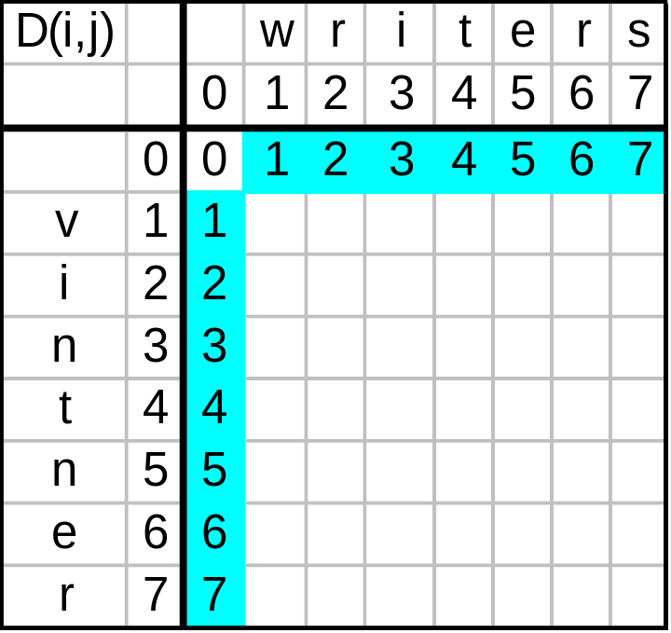
Dynamic Programming
Example: edit distance from vintner to writers.
Fill in the base condition values.

Slide 84
Dynamic Programming
Q: How do we fill in the other values?
A: use the recurrence:
  D(i,j) = min[D(i - 1, j) + 1, D(i, j - 1) + 1, D(i - 1, j - 1) + t (i,j) ]
  where t (i,j) = 1 if S₁(i) ≠ S₂(j), o/w t (i,j) = 0.
We can first compute D(1,1) because we have D(0,0), D(0,1), and D(1,0)
  D(1,1) = min[ 1+1, 1+1, 0+1] = 1
Then we have all the values needed to compute in turn D(1,2), D(1,3),..,D(1,m)

Slide 85
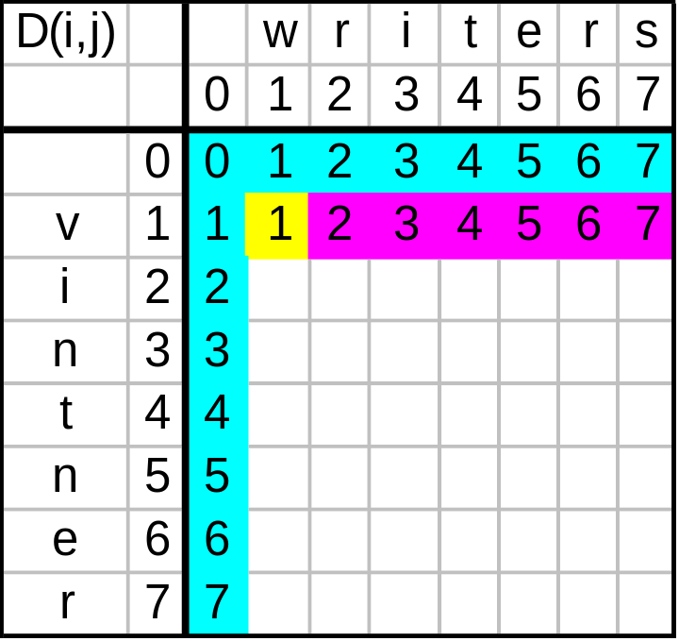
Dynamic Programming
First compute D(1,1) because we have D(0,0), D(0,1), and D(1,0)
Then compute in turn D(1,2), D(1,3),..,D(1,m)

Slide 86
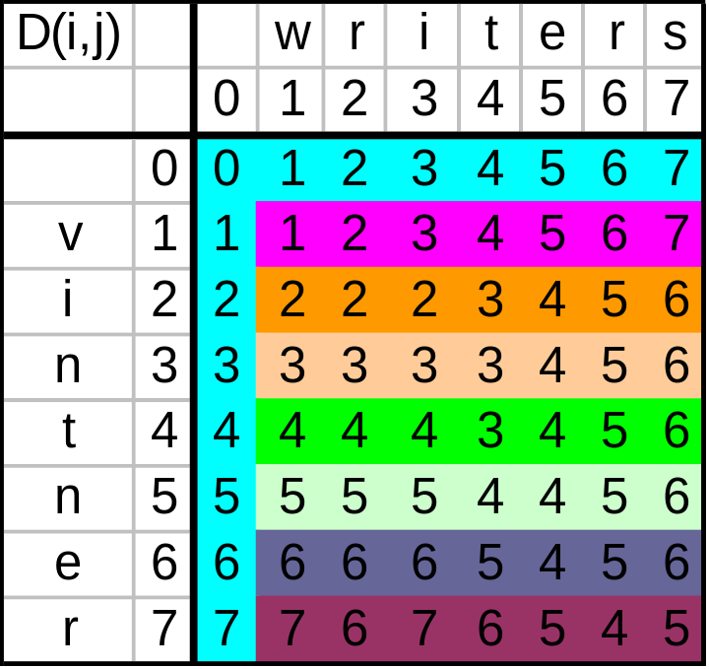
Dynamic Programming
Fill in subsequent values, row by row, from left to right.

Slide 87
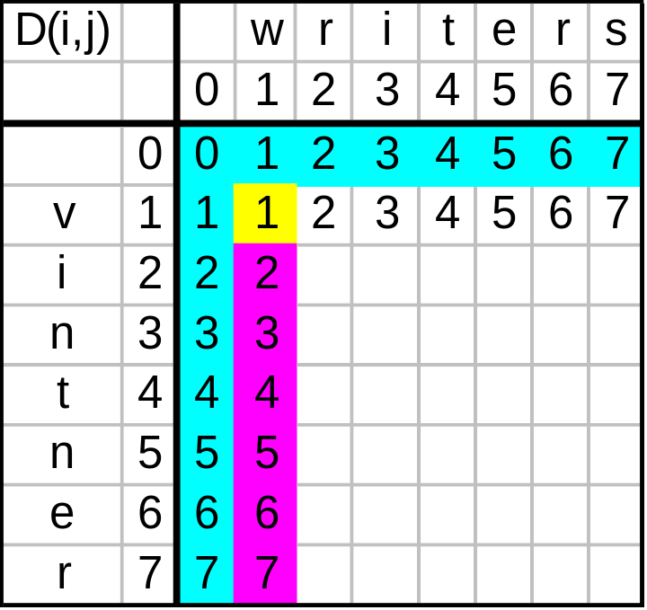
Dynamic Programming
Alternatively, first compute D(1,1) from D(0,0), D(0,1), and D(1,0)
Then compute in turn D(2,1), D(3,1),..,D(n,1)

Slide 88
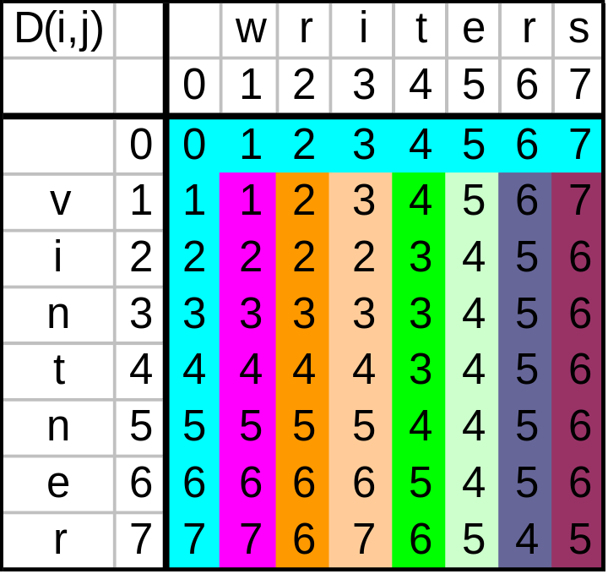
Dynamic Programming
Fill in subsequent values, column by column, from top to bottom.

Slide 89
Dynamic Programming
Filling each cell entails a constant number of operations.
  Cell (i,j) depends only on characters S₁(i) and S₂(j) and cells (i - 1, j - 1), (i, j - 1), and (i - 1, j).
There are O(nm) cells in the table
Consequently, we can compute the edit distance D(n, m) in O(nm) time by computing the table in O(nm).

Slide 90
Summary
We can apply probabilistic modeling to NL problems like spell-checking
  Noisy channel model, Bayesian method
  Training priors and likelihoods on a corpus
Dynamic programming approaches allow us to solve large problems that can be decomposed into subproblems
  e.g. MED algorithm
Apply similar methods to modeling pronunciation variation

